Slide 1
2016 Mandatory Corporate Compliance
1

Slide 2
Why you are reviewing this training material
Compliance programs are not a new thing in healthcare or at Lahey
Health. But we can’t just assume that everyone is on the same page about what our Compliance program requires of each of us.
This training material has 4 sections plus a post-test. By January 31, 2017, you must review all 4 sections and get at least 15 of the 18 post-test questions correct to complete this training.
2

Slide 3
Here are the 4 Sections that will be covered:
Protecting the Privacy and Security of Patient Information
Putting each Patient’s Care, Safety, Dignity and Well-Being ahead of Everything Else
Speaking Up
Managing Conflicting Interests
3

Slide 4
CHAPTER 1
Protecting the Privacy and Security of Patient Information
Let’s get started ....
4

Slide 5
It's about trust
5

Slide 6
A healthcare employee who was not on
a patient’s care team accessed the
patient’s lab results - and shared them
with the patient’s mom and sister....
6

Slide 7
A healthcare worker’s mother was worried about the results of her lab tests. He looked up her test and told her the results before her doctor could explain what the results meant…
7

Slide 8
The family of a trauma patient overheard
staff talking about the patient on a
cellphone to someone outside the
hospital ....
8

Slide 9
Two hospital employees took pictures
of a patient’s amputated leg – and
posted them on Facebook....
9

Slide 10
Each of these cases actually
happened ... and was
reported to authorities and
the patients involved.
10

Slide 11
Would you want any of these employees taking care
of you or your family members?
11

Slide 12
A real newspaper headline:
“Six People Fired from Hospital
Over Patient Privacy”
12

Slide 13
Does that headline make you more -
or less - willing to be a patient at that hospital?
13

Slide 14
In a 2015 survey of patients...
54 % reported they would switch to another healthcare provider if they
were notified of a data breach at the one where they were currently
getting their care
21 % reported already choosing not to share certain information with
their provider because of fear of a data breach
HIPAA Breaches: Minimizing Risks and Patient Fears
http://www.softwareadvice.com/medical/industryview/hipaa-breaches-report-2015/
14

Slide 15
In another survey...
73% of patients reported that if there were serious or repeated
breaches of patients’ personal information at a hospital where they had
treatment, it would reduce their confidence in the quality of healthcare
offered by the hospital.
UK: How Privacy Considerations Drive Patient Decisions
and Impact Patient Care Outcomes (2011)
http://www.fairwarning.com/wp-content/uploads/2015/09/2011-10-WP-UK-PATIENT-
SURVEY.pdf com/wp-content/uploads/2015/09/2011-10-WP-UK-PATIENT-SURVEY.pdf
15

Slide 16
Each day we have
opportunities to add to - or
damage - the trust patients
and their families place in
Lahey Health
Protecting the Privacy and Security of Patient
Information – it’s about each one of us
16

Slide 17
You know “the Rules”
“Comply at all times with the Confidentiality
Statement you signed at the outset of your
association with Lahey Health.” – Lahey Health Code
of Conduct
Do not let curiosity be your guide - there is
nothing so interesting that it’s worth losing
your position to look at it.
Passwords – don’t share them. You are
accountable for what’s done under yours.
Emails containing Protected Health
Information must be encrypted before
being sent. And do not reply to an outside
email containing PHI in the thread that
goes back out to the sender unencrypted.
Your facility’s privacy official
is ALWAYS there to answer
questions and clarify the
rules.
17

Slide 18
Protecting the Privacy and Security of
Patient Information
It’s about laws like HIPAA ...
It’s about each one of us....
But most of all it’s about trust
18

Slide 19
Chapter 2
Putting Each Patient’s Care, Safety, Dignity And
Well-being Ahead Of Everything Else
Let’s get started ....
19

Slide 20
Putting Patient Care, Safety, Dignity and Well-being ahead of everything else
Sounds easy?
20

Slide 21
This includes:
Proper patient identification;
Making sure all patients can access our services equally;
Providing additional “aids” to some patients to achieve that equal access;
Following policies, rules and regulations and;
Sometimes saying “No”.
21

Slide 22
Proper patient care starts with proper patient identification.
Patient identification is one of the most critical processes colleagues must follow. To ensure the right patient receives the right care at every encounter, always use at least two identifiers:
Full Name
Date of Birth
Other, if needed
22

Slide 23
Making sure all patients can access our services equally
means:
Watching for signs that patients can’t hear or see well
Offering assistive aids like:
portable amplifiers, communication boards,
captioning and qualified interpreters
23

Slide 24
Did you know...
About 33% of our patients between the ages of 61-70, and
85% of those over the age of 85, probably have some hearing loss?
And they may not volunteer – or even admit - this fact.
But if they can’t hear you, they aren’t asking or answering the
questions needed for the best care.
24

Slide 25
Equal access also means...
Accommodating patients’ own assistive devices – hearing aids, guide dogs, and glasses - wherever and whenever possible.
It’s our duty – and also good care.
25

Slide 26
“Strategies” to avoid
Talking LOUDER
Addressing information and questions to the patient’s spouse, companion or other
family member – instead of the patient
Would you want your caregivers to SHOUT at you? Or speak to your
family members instead of you about your care?
Care, Safety, Dignity and Well-being - ahead of everything
26

Slide 27
Equal access also means...
 | using qualified interpreters isn’t optional.
27

Slide 28
Did you know...
In the Boston area:
– At least 138 different languages are spoken at home
– 23% of those age 5 and over speak a language other than
English at home
Census Bureau Reports at Least 350 Languages Spoken in U.S. Homes (Nov. 3, 2015)
28

Slide 29
If you and the patient can’t communicate...
How will you ensure |  | –appropriate care –pain management –informed consent –medication reconciliation –patient education
Care, Safety, Dignity and Well-being – ahead of everything
29

Slide 30
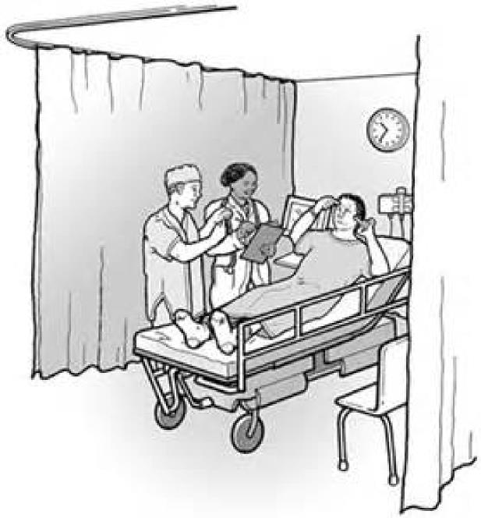
Interpreter Dos and Don’ts
Do know how to access interpreter services - in person and by telephone - in the areas and settings where you work.
Do let the patient know that interpreter services are available without charge.
Don’t suggest that a family member or friend of the patient be the “interpreter”.
30

Slide 31
Examples of some Policies, Rules and Regulations:
Speaking Up Policy - Lahey Health Policy on Speaking Up
HIPAA (Health Insurance Portability and Accountability Act) - A 1996 Federal law that restricts access to individuals' private medical information.
EMTALA (Emergency Medical Treatment & Labor Act) - A federal law that requires us to stabilize and treat anyone who comes to our emergency department, regardless of their insurance status or ability to pay.
Stark Law – Generally prohibits physician referrals for certain ancillary health care services to entities or organizations with which the physician (or a member of the physician’s immediate family) has a financial relationship, unless an exception to the law applies.
Contract Policy - Lahey Health Contract Review Policy
31

Slide 32
Saying “No”
Sometimes patients, their family members or others may ask us to do something that’s wrong – maybe even something that violates the law.
Other times a patient may want to form a personal relationship with their caregiver that is outside the boundaries of professional conduct.
It’s never easy, but in those cases the right answer is a respectful, but clear “No”.
32

Slide 33
So, for example...
Some patients may ask that colleagues of a particular race or
nationality be assigned – or not assigned – to take care of
them.
They have every right to ask this, but granting their request
and assigning staff for that reason violates the law and the
rights of the colleagues involved.
Sometimes you have to say “No”.
33

Slide 34
Putting
Patient Care, Safety, Dignity
and Well-being ahead of
everything
Not always easy . . .
But ALWAYS the right thing
to do
34

Slide 35
Chapter 3
Speaking Up
Let’s get started ....
35

Slide 36
You’ve probably seen this logo
somewhere during the past year.
In this section of the training you
will learn why Speaking Up is
important, how you can do it,
and why “Compliance will be
there when you do.”
36

Slide 37
What is it all about?
Like privacy... Speaking Up is partly about trust. It’s about the trust each of us has in our colleagues, our leaders and the organization itself.
What is in it for you?
Though we all want to do our best at work, sometimes, we make mistakes. By respectfully telling a colleague that he has made a mistake, you build trust and constructively address the problem.
Speaking up is not easy, especially when you have seen something that may be illegal, unethical or otherwise improper. When we can trust each other enough to speak up, we ALL win!
37

Slide 38
And ...
Speaking Up is also about making Lahey better.
That’s why our Code says “It is our duty to speak up – so that Lahey can
address problems and keep them from happening again.”
Go here to see the Lahey Health Code of Conduct:
http://massshare/sites/corpcomp/Pages/Code-of-Conduct.aspx
It is also why we have a policy called “Speaking Up About Dangerous,
Illegal or Unethical Conduct”.
38

Slide 39
Patients or colleagues may be hurt!
Things don’t get fixed
We may act based on “bad”
assumptions or information
Lahey may be subject to penalties or
fines
We are distracted from pursuing
Lahey’s mission
Money, time and energy can be
wasted
Every time one of us
doesn’t speak up when
we see something that
looks dangerous,
unethical, illegal or otherwise improper...
39

Slide 40
What are some of the dangerous, unethical, illegal or otherwise improper concerns that should be reported?
Anything that might cause physical or psychological harm
Failure to provide necessary care - or providing medically unnecessary care
Billing for care that is not provided or not documented
Other improper documentation issues
Stealing, wasting or personal use of Lahey resources
Failure to follow Lahey policies or procedures or The Code of Conduct
Retaliation against someone who has raised a concern in good faith
Discrimination or harassment
Anything that does not “feel right”
If you think you saw something, say something!
Speak up! Compliance will be there when you do!
40

Slide 41
Yes, Speaking Up isn’t easy
41

Slide 42
Reasons People Give for Not Speaking up
“Nothing has ever changed when I
spoke up in the past”
“I’m not sticking MY neck
out”
“No one
ever said
life is fair”
“I’m
afraid”
42

Slide 43
But
whatever the
reason for it
Silence isn’t
harmless
43

Slide 44
4 Ways to Speak Up
Speak directly with the person involved. That shows the person the respect and dignity you would want if the situation were reversed. It also gives you a chance to check any assumptions you have made.
Speak to the person’s supervisor – or your own.
Seek guidance from members of the Compliance, Legal and/or Human Resources teams.
Put your concern in SafeSpot (if available) or call the Compliance Hotline (855-392-5782) or go online (www.laheyhealth.ethicspoint.com).
44

Slide 45
Compliance Reporting
Compliance tracks inquiries and concerns through Safespot* and the Compliance Hotline.
Safespot* and the Compliance Hotline are places where you can raise a concern that you believe Compliance should investigate further, or where you can make a Compliance-related inquiry. All reports/inquiries will be kept as confidential as possible.
*Safespot is not available at Winchester Hospital, but coming soon!
45

Slide 46
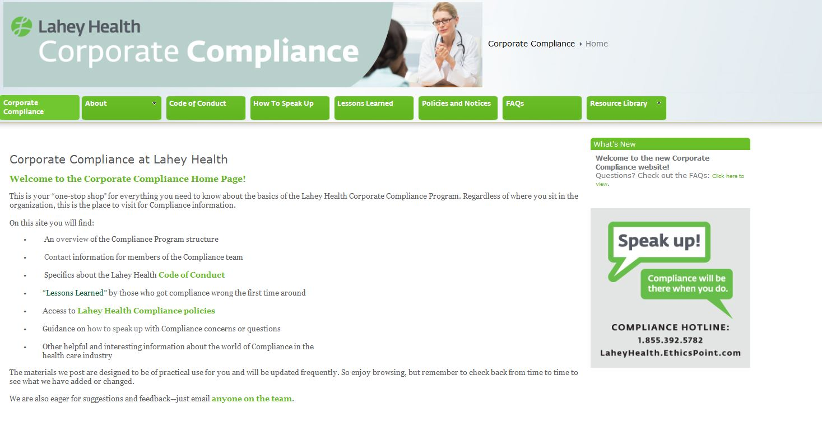
46
Resources — there's a page for that!

Slide 47
Your Speaking Up is protected.
By Lahey – “Lahey Health will not tolerate retaliation of any kind – not
even in the form of a cold shoulder - against a person who reports a
concern in good faith.” (Code of Conduct)
By Compliance, Legal Services and HR colleagues – whose job it is to
create a safe outlet for those who speak up and to investigate reports.
By the State of Massachusetts * – in laws against retaliation
By the federal government * – which also has laws against retaliation
* Learn more about these laws on the Compliance Intranet site:
http://massshare/sites/corp comp/Pages/Policies.aspx
47

Slide 48
Lahey Leaders – you have an additional duty
“Urge others to raise concerns of illegal,
unethical or other improper conduct, and
protect those that do so from retaliation in
any form.”
48

Slide 49
Speaking Up
Sometimes it may seem scary ...
But in the end, it’s about making things better.
It’s about trusting those we
work with, our leaders and Lahey
Itself.
49

Slide 50
Chapter 4
Managing Conflicting Interests
Let’s get started ....
50

Slide 51
It’s about integrity
51

Slide 52
An administrative director
signs a supply contract for
her department - with a
company for which she does
independent consulting ....
52

Slide 53
A surgeon designed an implant
device, gets royalties from the
company that sells it, and wants to
use the device in his patients’
operations....
53

Slide 54
A patient’s father comes up to a colleague and
says “I’m sure you will take great care of my child”
while holding out a $50 bill.
54

Slide 55
Situations like these happen
... and the potential conflicts
of interest need to be
recognized and managed.
55

Slide 56
A real newspaper headline:
“[Physician] Group Faces Scrutiny
Over Drug Industry Ties”
56

Slide 57
Does that headline make you more -
or less - willing to get your medical care
from that group practice?
57

Slide 58
Your father is a patient and sees another
patient give a nurse a large, wrapped gift
box. Does that make him think that he
might not be treated well – unless he also
gives gifts to those taking care of him?
58

Slide 59
Possible conflicts of
interest situations happen to all of us.
59

Slide 60
Having a conflict of interest doesn’t mean
that you have done anything wrong. But
there are right – and wrong – ways to act
when conflicts present themselves.
60

Slide 61
You know “the Rules”
“Always disclose facts and
circumstances that might give even the
appearance of a conflict of interest or a
personal benefit to you.” – Lahey
Health Code of Conduct
A personal benefit to you includes the
business relationships, investments
and employment or professional
associations that members of your
immediate family have – not just your
own.
Depending on the level of your
responsibilities, you may also be
required to complete and submit an
annual conflict of interest
questionnaire and to update it during
the year, if circumstances change.
If you’re not sure whether you have a
conflict of interest between your
personal interests and your job
responsibilities, ASK!
61

Slide 62
Rules about gifts from patients
At Lahey, our policy on gifts says that in general we don’t
accept personal gifts from patients or their family members or
friends.
The exception is:
“A Colleague may accept a gift ... if the gift is of nominal
monetary value (such as a flower arrangement, holiday basket,
baked good or the like); in such cases the Colleague is
encouraged to share the gift with others in the Colleague’s
department.”
Accepting gifts of cash, cash equivalents or any item of other
than a nominal monetary value is prohibited.
62

Slide 63
Gifts from those we do or might do business with
Our Code of Conduct, gift policy and vendor interactions policy are all clear – “Do not
accept any gift from those with whom we currently, or may, do business.”
What’s a gift?
Entertainment or recreational items (such as golf balls, sports bags, artwork, CDs,
tickets to sporting events, theater, etc.)
Cash, gift cards, gift certificates and coupons
Calendars, pens, coffee mugs and other advertising novelties
Holiday gift baskets and other food or beverage items
Meals and refreshments at restaurants or elsewhere
Grants, scholarships and medical related items
Travel expense reimbursement
Any other items, services or payments
63

Slide 64
Conflicts of Interest – integrity is in how you manage them.
64

Slide 66
Still have questions?
You have lots of resources for getting answers: | Your local Privacy Officer or Compliance Director The Lahey Health Privacy/Confidentiality policies The Chief Compliance and Privacy Officer The Compliance Hotline (855-392-5782 or www.laheyhealth.ethicspoint.com) The Compliance website on your Intranet (http://massshare/sites/corpcomp/Pages /Home.aspx) (For most of you) SafeSpot on your Intranet A member of the Legal Services Department (781-744-5252)
65

